Slide 1
Why isn’t Technical Communication’s Definition as Concise as its Practices?
Molly Blair

Slide 2

Who Are the Respondents?
Heather Steele (CMO, Blue Steele Solutions)
Laura McKnight (Grant Writer, reStart Inc.)
Michael Alford (Retired
Director of Data Marketing
for Fireman’s Fund
Insurance)

Slide 3



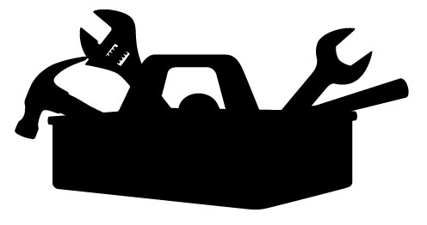
What’s In the Communicator’s Toolbox?

Slide 4



What’s In the Communicator’s Toolbox?
Flexibility
Research
Confidence

Slide 5


Collaborative or Independent?

Slide 6




Can We Work From Home?

Slide 7

Does Tech Writing Interfere with Family?

Slide 8
Where are the Jobs?

Slide 9
What are the Jobs Called?

Slide 10





What Are the Responsibilities?

Slide 11
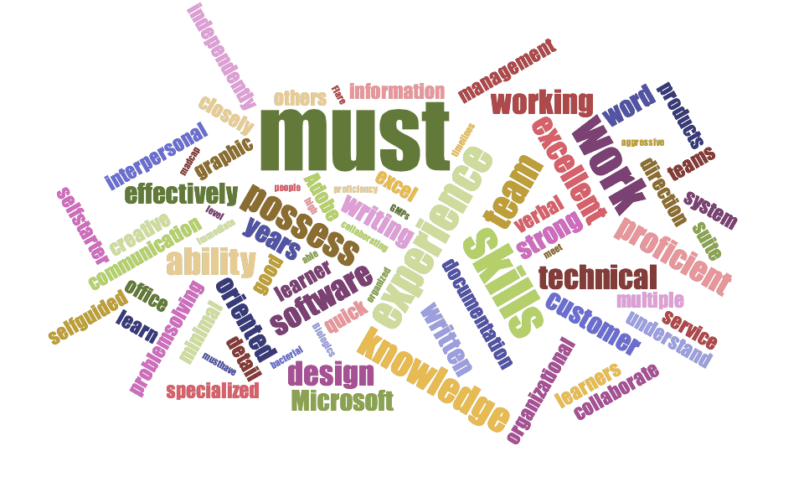
What are the Required Skills?

Slide 12

Key Similarities
“Soft Skills” vs Tools
Collaboration and Independent Work

Slide 13
Key Differences
Job Titles
Document Sharing Software
TECHNICAL WRITER?
CONTENT STRATEGIST?
DATA ANALYST?

